Slide 1

Septic to Sewer
Program Update
Rich Easter, Southern Nevada Water Authority
septictosewer@snwa.com

Slide 2
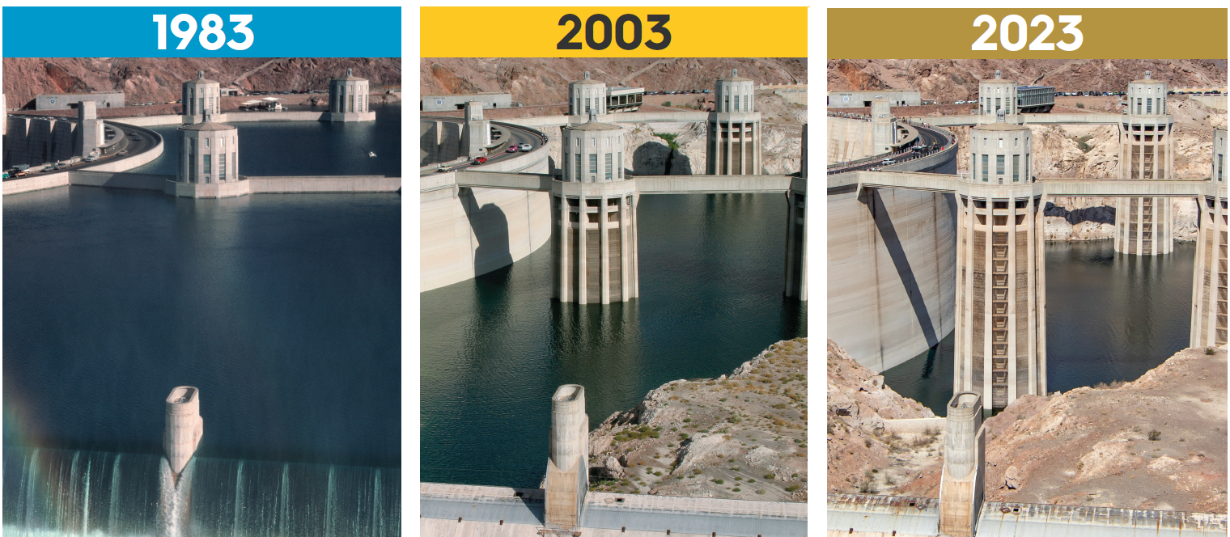
Severe and sustained drought conditions continue to impact critical storage reserves in the Colorado River Basin.

Slide 3




INFRASTRUCTURE
Constructing major facilities and asset management
RESOURCE PLANNING
Southern Nevada has spent decades preparing for drought to ensure the reliability of water supplies for Southern Nevada
Working with partners & developing comprehensive plans to manage supplies
WATER BANKING
Storing water supplies for the future
CONSERVATION
Incentives, programs, regulation & pricing

Slide 4
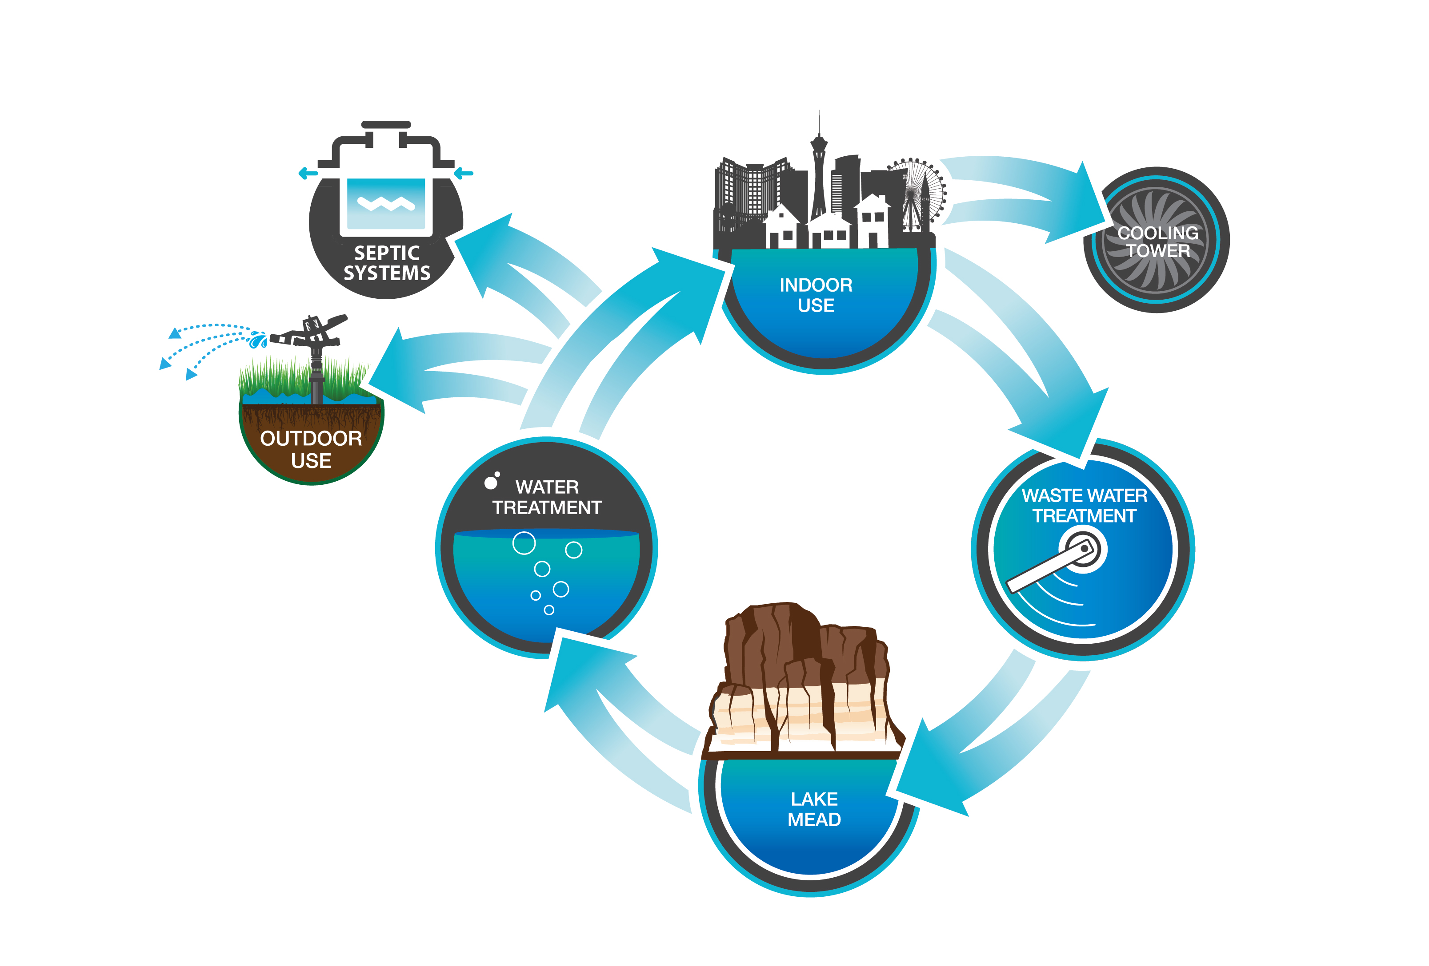


Why Septic Systems?
Increase reuse and return flow credits to the Las Vegas Valley.
Enhanced protection of groundwater aquifers in Southern Nevada.

Slide 5
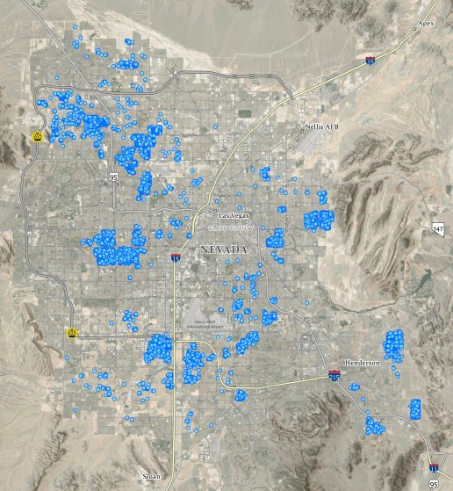
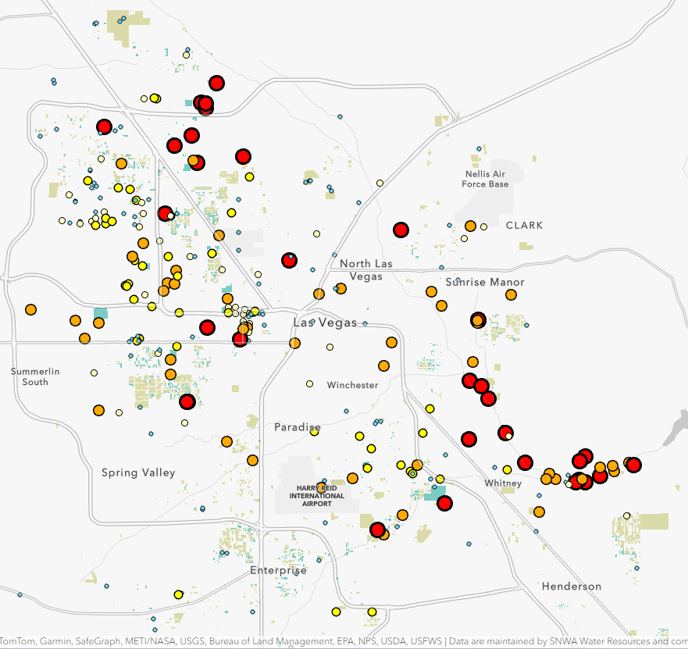
Why Septic Systems?
Notes:
Red areas over 10mg/L

Slide 6
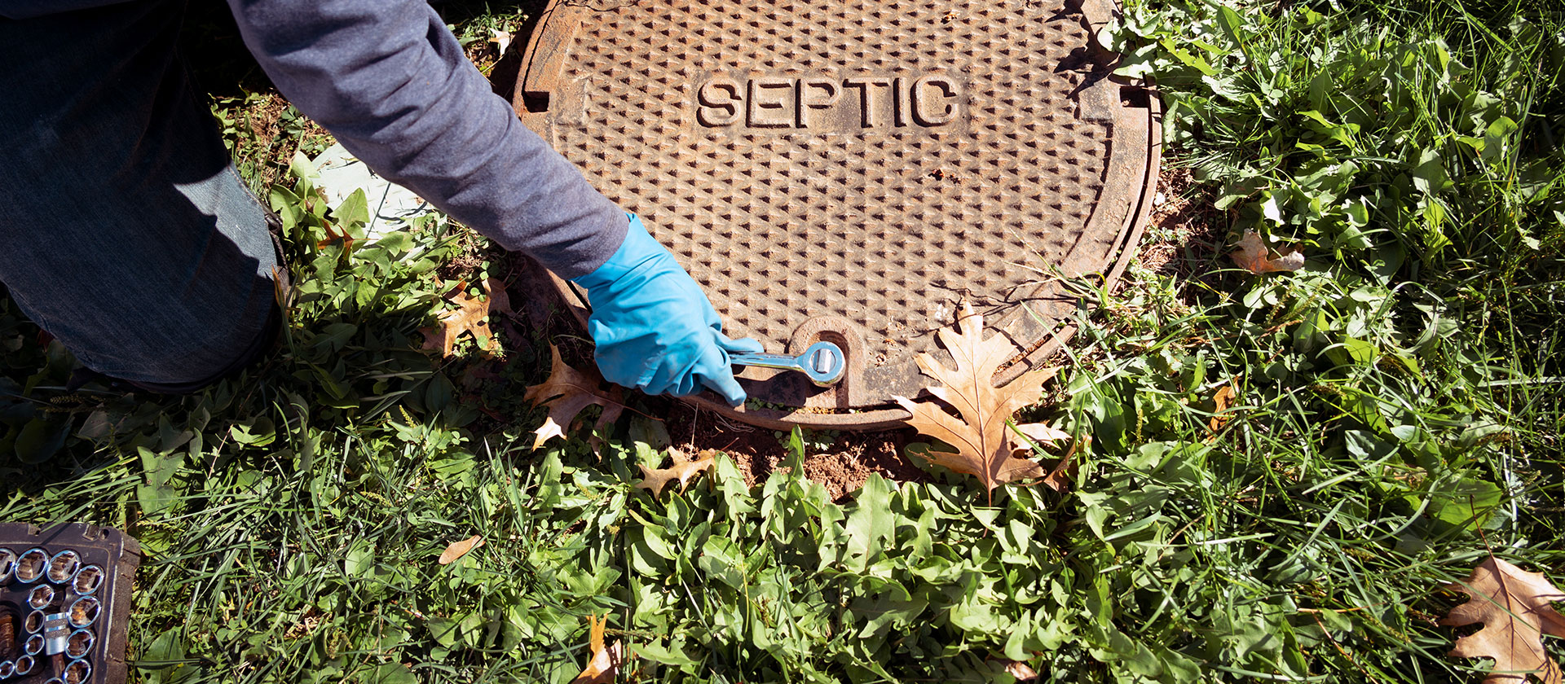

SNWA Septic Conversion Program

Slide 7
SNWA Septic Conversion Program
Partially Funded Program
Eligible Costs:
Permitting/inspection fees ​
Connection fees​
Design fees​
Construction costs​
Like-for-like landscape replacement​
Septic abandonment in place
Ineligible Costs:
Landscape upgrades​
Septic tank removal
Open to all existing septic owners
  Well abandonment not required
Reimbursement for 85% of project, up to $40k
Homeowner works directly with contractor
Group conversions encouraged
https://www.snwa.com/rebates/septic-conversion

Slide 8
SNWA Septic Conversion Program
Partially Funded Program | Muni Water User | GMP | Total
Total # of submitted apps | 242 | 82 | 324
Total # In NTP Stage (contractor bid approved) | 18 | 9 | 27
Total Completed | 10 | 4 | 14
Total Reimbursed | $325,035.06 | $143,003.17 | $468,038.23
Balance | $960,000.00 | $356,996.83 | $1,316,996.83
Average Homeowner Cost | $11,379.48 | $8,515.87 | $9,947.68
https://www.snwa.com/rebates/septic-conversion

Slide 9
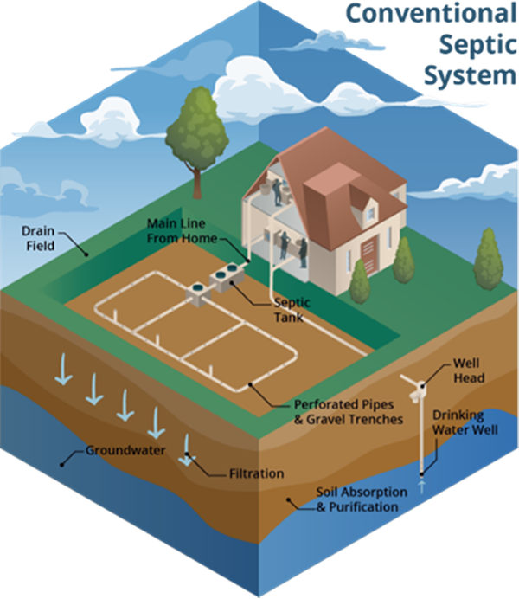
SNWA Septic Conversion Program
Fully Funded Program
~$13M in federal grant dollars
  BOR/EPA/ARPA
Selected by SNWA/Sewer Agencies
  Early focus on lateral-only
Residential parcels with septic and municipal water
SNWA-hired contractor
Begins early 2025
https://www.snwa.com/rebates/septic-conversion

Slide 10
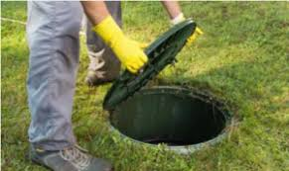

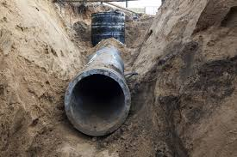
Key Takeaways
Septic conversions protect and extend Southern Nevada’s water supply
Financial assistance is available for voluntary conversions today
No quick fix – in it for the long haul

Slide 11
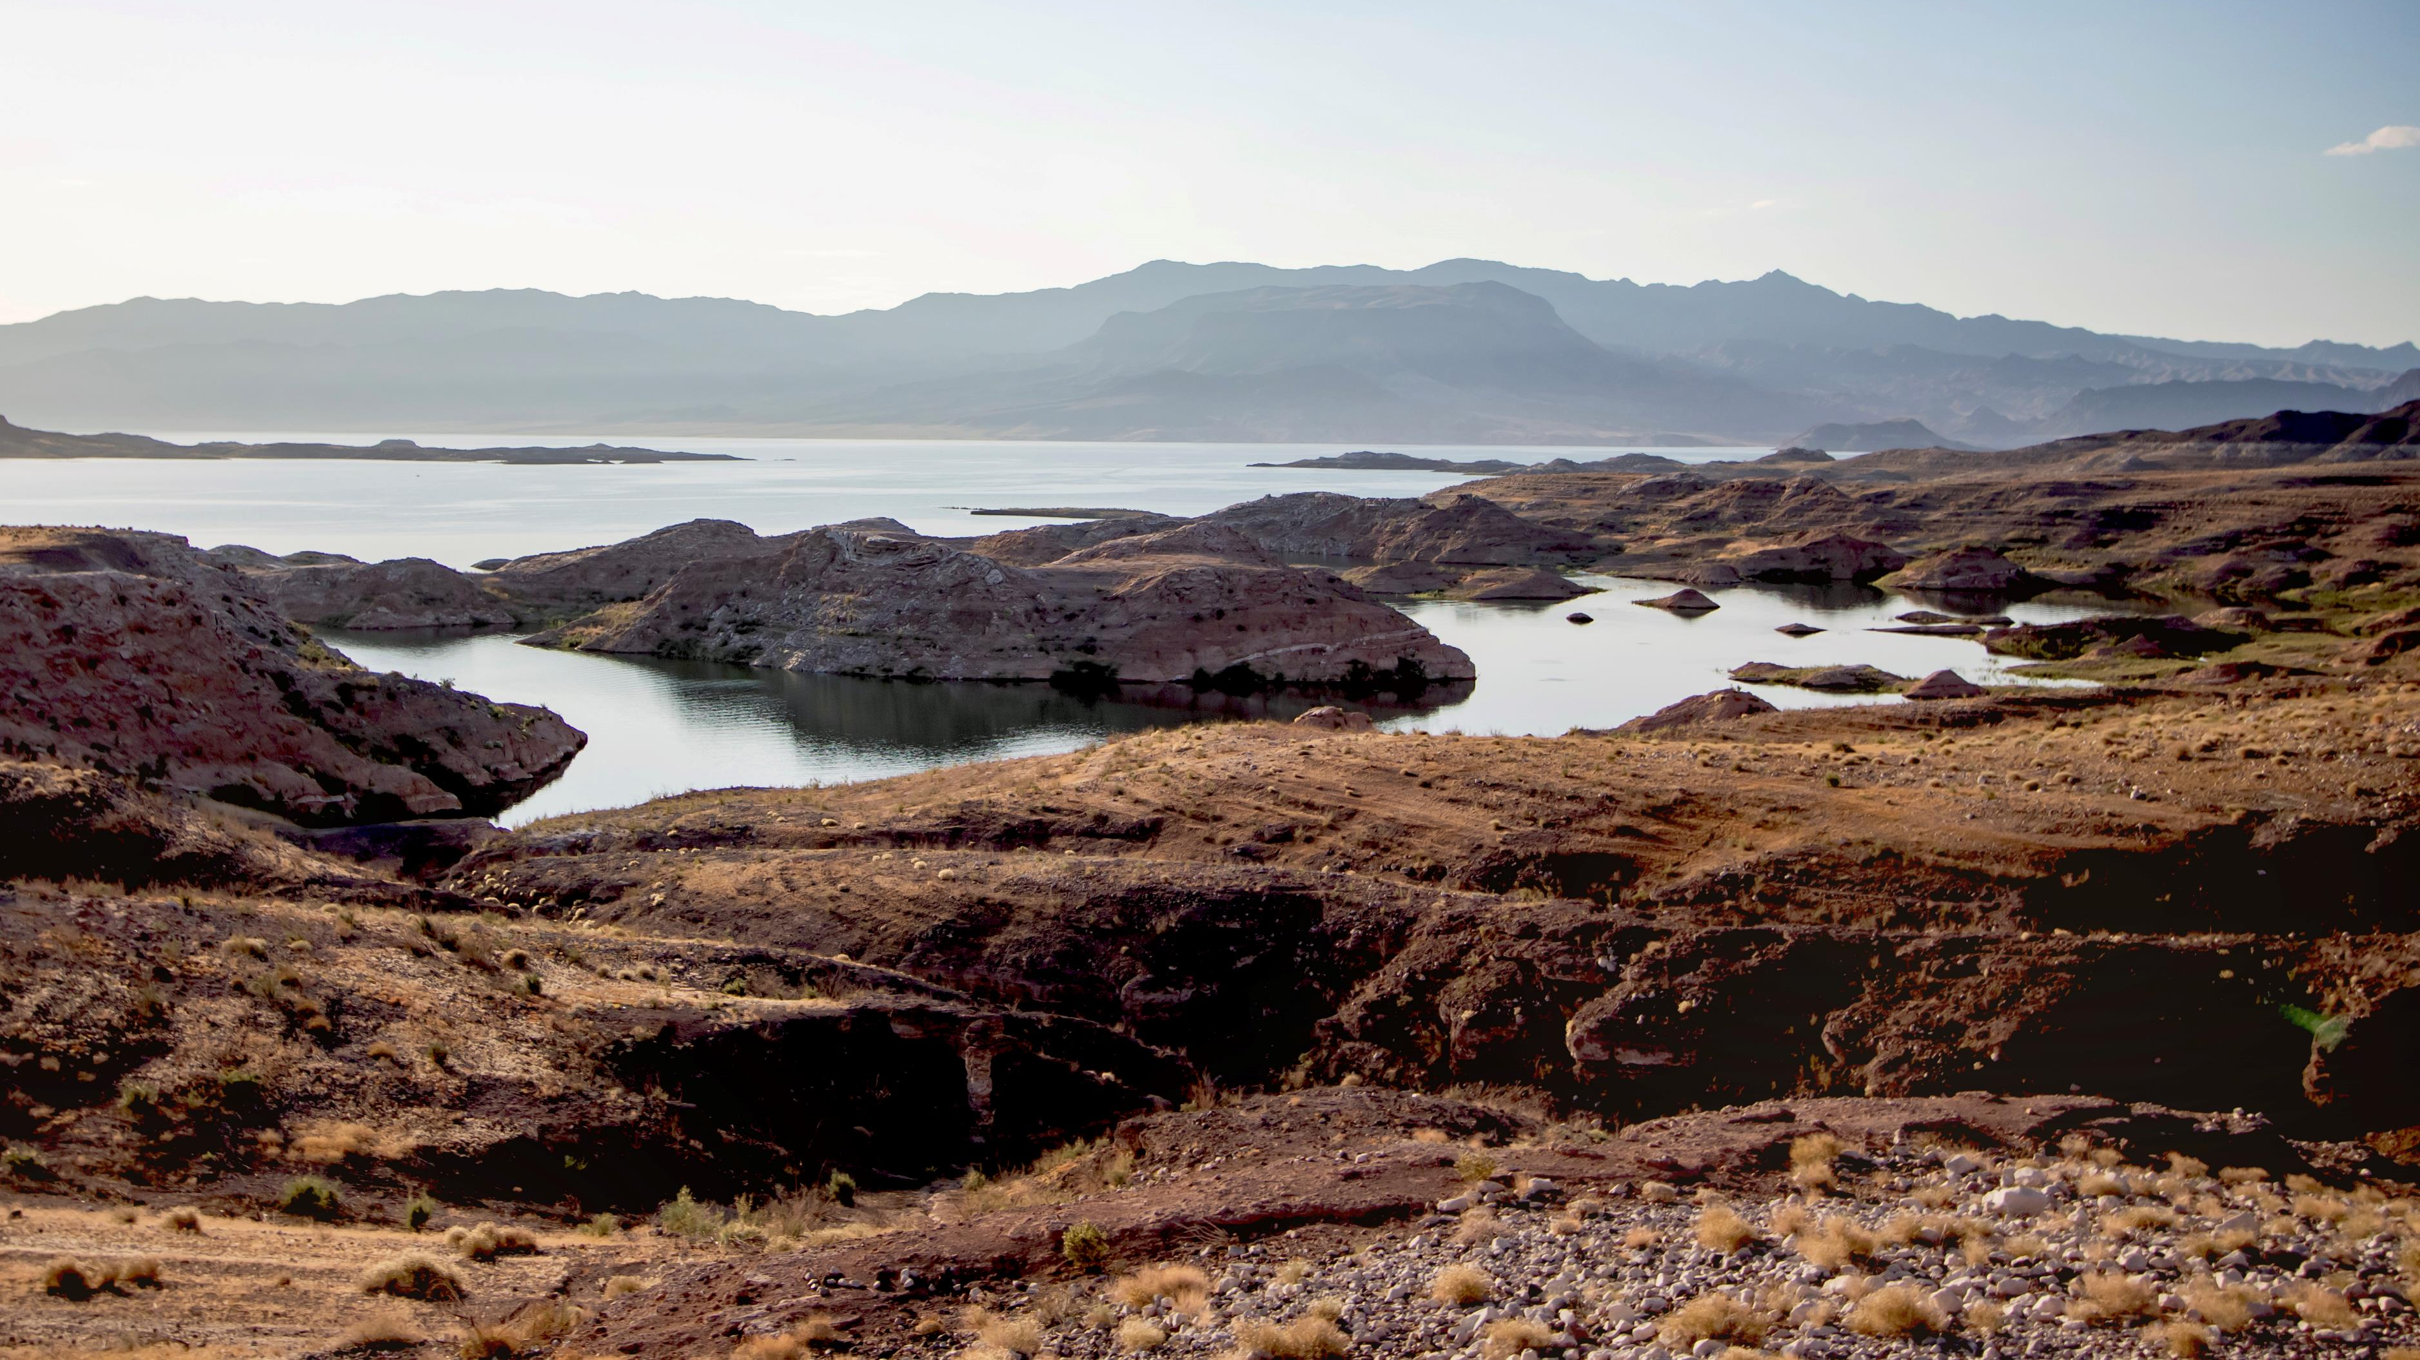
Q+A

